Slide 1
Stacks
CS 201, Summer 2013

Slide 2
ADDITIONAL READING
Stacks
  https://en.wikipedia.org/wiki/Stack_(abstract_data_type)
  http://www.cprogramming.com/tutorial/computersciencetheory/stack.html

Slide 3
Data Structures
A stack is another type of data-structure, which can be implemented with a Linked List structure.
A Stack restricts how you can access elements of the List.
With Stacks, you can only push to and pull from the top of the stack.
  You cannot access something on the bottom of the Stack if there are elements “above” it.

Slide 4
Data Structures
LIFO and FILO refer to how a Stack works-
  Last In, First Out
  First In, Last Out
  Essentially the same thing.
You will see “FIFO” for a Queue
  First In, First Out
  Similar to standing in line at the bank

Slide 5
Data Structures
The Standard Template Library in C++ contains a stack container:
http://www.cplusplus.com/reference/stack/stack/
Has functionality:
  push
  pop
  top
  size

Slide 6
Data Structures
The Standard Template Library in C++ contains a stack container:
http://www.cplusplus.com/reference/stack/stack/
Has functionality:
  push
  pop
  top
  size

Slide 7
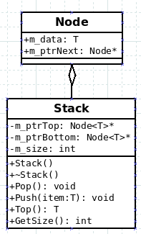
Implementing a Stack in C++...
Like a Linked List and Queue, the Stack class contains pointers to Nodes.
Here, we will store a pointer to the Top and Bottom Nodes, so we can easily access the Top.
Think of the Bottom as the starting point, and the Top as the last item.

Slide 8
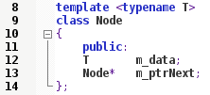
Implementing a Stack in C++
The Node
The Node will contain data, which in this case is an undetermined type T.
The Node also contains a pointer to the next Node in the list.

Slide 9
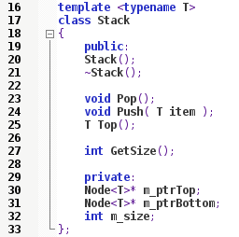
Implementing a Stack in C++
The Stack
The Stack contains two Node pointers (remember to add the <T>!) and the size of the Stack.
It also contains functionality for
  Constructor
  Destructor
  Pop
  Push
  Top
  Getting the Size

Slide 10

Implementing a Stack in C++
Stack Constructor
Within the Constructor, we set the pointers equal to NULL (which is equal to 0 in C++98), and set the size equal to 0.
I am using an initializer list here.

Slide 11
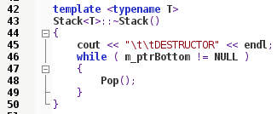
Implementing a Stack in C++
Stack Destructor
Within the Destructor, we will want to Pop every item off the Stack, while there are still items to pop.
We will know the Stack is empty, when the first item pointer (m_ptrBottom) is NULL.
  When we remove data, we will set the appropriate pointer to NULL.

Slide 12
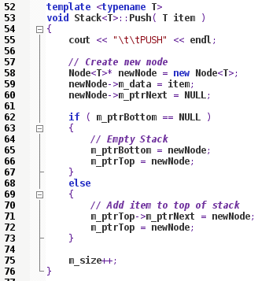
Implementing a Stack in C++
Stack Push
When we Push a new item, we will need to create a new Node. This isn't a Dynamic Array, but it is a Dynamically allocated variable.
Then, if the Stack is empty we will set the Top and Bottom pointers to point to our new Node.
If there is already elements on our Stack, this new Node becomes the top of our Stack.

Slide 13
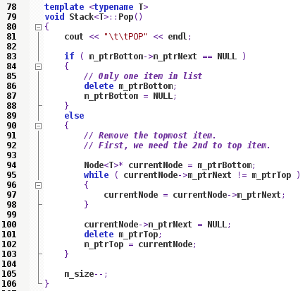
Implementing a Stack in C++
Stack Pop
When we Pop an item off the list, if the Stack only has one item, we delete it and reset the Bottom pointer to NULL.
Otherwise, if there is more than one item in the list, we need to find the penultimate Node.
The 2nd-to-last Node will become our new Top Node after we delete what is currently at the Top.

Slide 14
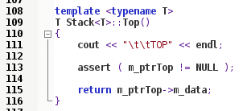
Implementing a Stack in C++
Stack Top
When we want to get the Top item from the list, we simply return the data stored in the Top Node.
We need to use the Top pointer of the Stack.

Slide 15

Implementing a Stack in C++
Stack GetSize
GetSize just returns our m_size variable.
GetSize just returns our m_size variable.

Slide 16
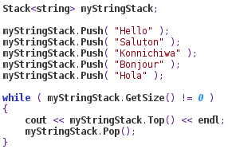
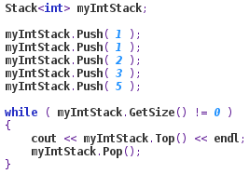
Implementing a Stack in C++
Stack GetSize
Then, elseware in our program, we can create Stacks that contain any data-type (including other Classes we create)

Slide 17
References

